Slide 1

Analysis on the Impact of Weather and Road Conditions on traffic accidents in USA
Rahul Kata | katarahul@gmail.com
Pavan A | pavanappanna7@gmail.com
Harsha Kulkarni | kulkarniharsha14@gmail.com

Slide 2

PROBLEM STATEMENT
To analyse the impact of various weather and road conditions on accidents in United States of America.
To predict the severity of the road accident given necessary attributes.
To unravel and visualize statistical insights.

Slide 3
DATASET DESCRIPTION
We have used a countrywide car accident dataset from kaggle, which covers 49 states of USA. This dataset emphasizes the severity of the accident on a scale of 1 to 4.
The accident data are collected from February 2016 to June 2020, using two APIs that provide streaming traffic incident (or event) data. These APIs broadcast traffic data captured by a variety of entities, such as the US and state departments of transportation, law enforcement agencies, traffic cameras, and traffic sensors within the road-networks.
There are about 3.5 million accident records in this dataset.
Total Records (rows) = 3513616
Total Attributes (columns) = 49

Slide 4
SIGNIFICANCE
Road traffic crashes are a leading cause of death in the United States for people aged 1–54,1 and they are the leading cause of non-natural death for U.S. citizens residing or traveling abroad - CDC
A WHO report states that - 1.35 million lives are lost yearly due to
road traffic accidents.
The data from accidents is very vital to improve the safety of transportation. It provides useful insights on the crucial factors that cause accidents.
With the advancement of technology and abundance of data, accidents must be analysed, predicted and avoided beforehand, given a set of conditions.
We intend to unravel these insights and present them in a intuitive manner.

Slide 5
APPROACH
Machine Learning
Models
EDA
INSIGHTS
Data Cleaning
Evaluations

Slide 6
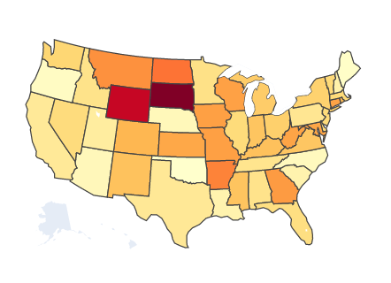
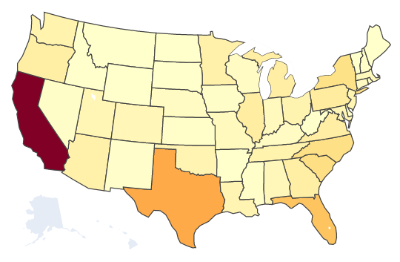
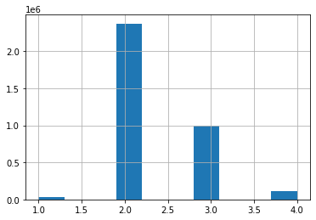
EDA
We have primarily used scatter plots, bar plots and histograms to visualize the dataset. We have also used geographical plots to understand the density of accidents.
Severity histogram
State-wise accident severity
State-wise accident count

Slide 7
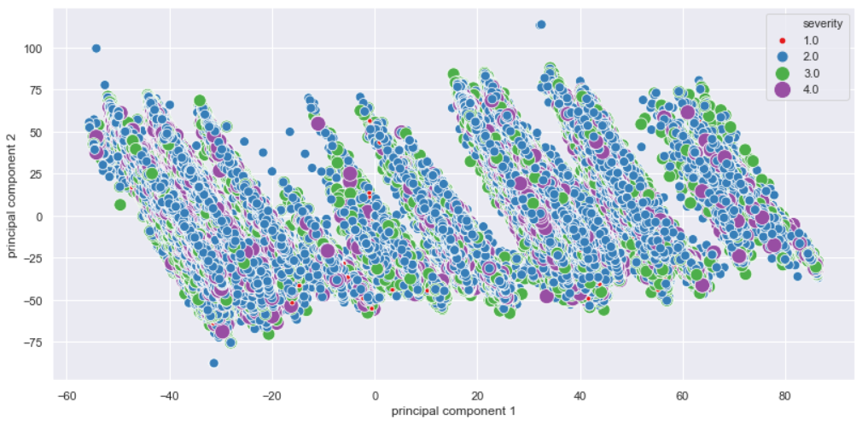
Scatter plot of PC1 and PC2

Slide 8
DATA CLEANING
US_Accidents
Numerical
Categorical
Mean Imputation
Median Imputation
Encoding
Mode Imputation
Normalization

Slide 9
MODELS
Sample dataset is split into (80-20) training and testing set using sklearn.
Stratified Cross Validation(10 folds) is used to validate each algorithm.
Logistic Regression was our baseline model. It failed to detect non-linear patterns in dataset.
KNN, Decision Tree and random forest performed fairly well.
Random_Forest
Decision_Tree
KNN
Log_Reg
Performance

Slide 10
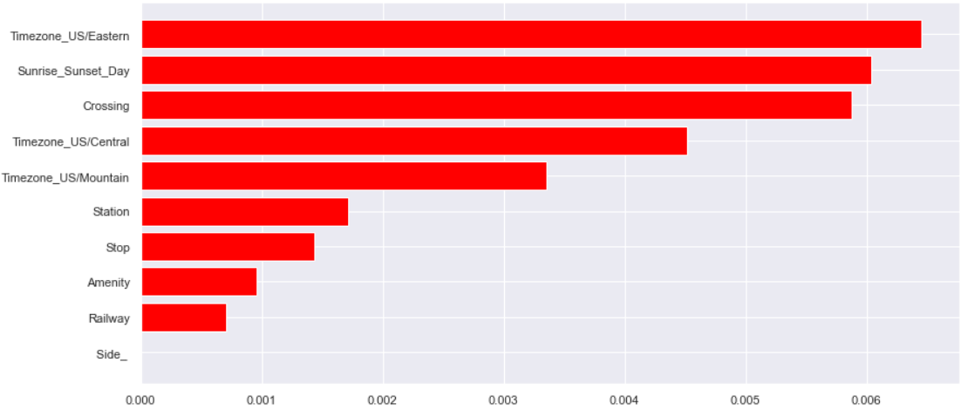
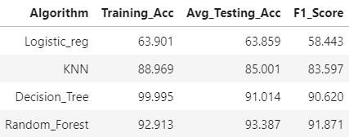
EVALUATION METRICS
Confusion matrix was plotted for each model and Accuracy and F1-Score were chosen as the evaluation metrics.
Overall Random Forest gave the best F1_Score followed by Decision tree classifier(entropy criterion).
Among the factors affecting the severity of road accidents, geographical location and time of the day plays a major role, as per the feature importance.

Slide 11
CONCLUSION
By utilising the default parameters for these models, proved unsatisfactory results.
The data was sampled so that severity values are proportioned out and avoid the models from becoming biased to one particular severity index. (without sampling Random Forest ~ 70% accuracy)
Feature engineering improved results by a huge amount and still stands as a reason why it is one of the most important and effective preprocessing steps in machine learning.
Default parameters for model settings proved inefficient and hence after several hyper-parameter tuning attempts optimum results were obtained.
Random Forest classifier could be used to test the severity and the probability of occurrence of an accident accurately. This solution can be further extended to predict accident occurrences in any country given the right set of data attributes.

Slide 12
CONTRIBUTIONS
Harsha Kulkarni
Final paper and code documentation.
Pavan
Model testing and evaluations.
Rahul Kata
EDA and Data Cleaning

